Slide 1
Fine Tuning LLM LLAMA-2

Slide 2
LLAMA-2
After the launch of the first version of LLaMA by Meta, there was a new arms race to build better Large Language Models (LLMs) that could rival models like GPT-3.5 (ChatGPT). The open-source community rapidly released increasingly powerful models. It felt like Christmas for AI enthusiasts, with new developments announced frequently

Slide 3
Understanding Llama 2 and Model Fine-Tuning
Llama 2, Meta's second-generation open-source LLM collection, features commercial licenses and is tailored for diverse natural language processing tasks. Models within the collection vary in scale, ranging from 7 billion to 70 billion parameters.
Llama-2-Chat, optimized for dialogue, matches the performance of closed-source models like ChatGPT and PaLM. Fine-tuning on a high-quality conversational dataset further enhances its capabilities.

Slide 4
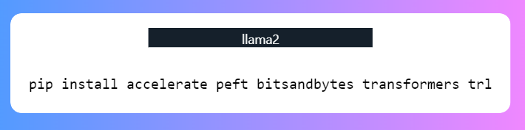
How to Fine-Tune Llama 2: A Step-By-Step Guide
We will use the QLoRA technique to fine-tune the model in 4-bit precision and optimize VRAM usage. For that, we will use the Hugging Face ecosystem of LLM libraries: transformers, accelerate, peft, trl, and bitsandbytes.
We will start by installing the required libraries.

Slide 5
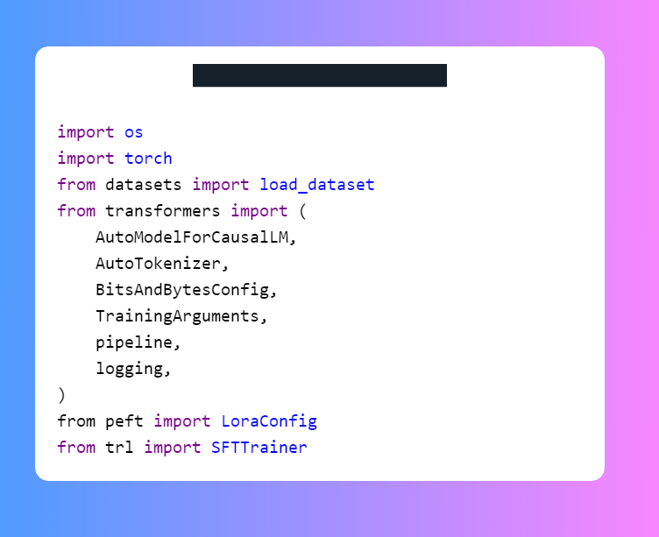
How to Fine-Tune Llama 2: A Step-By-Step Guide
After that, we will load the necessary modules from these libraries.

Slide 6
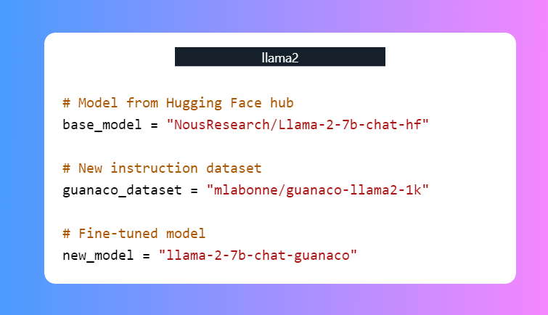
How to Fine-Tune Llama 2: A Step-By-Step Guide
We will fine-tune our base model using a smaller dataset called mlabonne/guanaco-llama2-1k and write the name for the fine-tuned model.

Slide 7
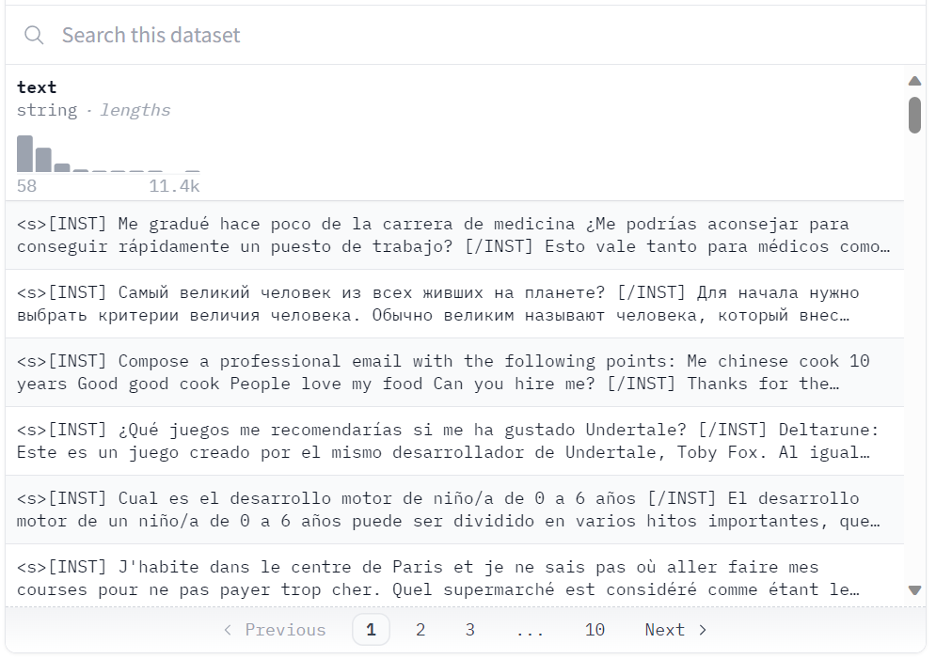
How to Fine-Tune Llama 2: A Step-By-Step Guide
We will fine-tune our base model using a smaller dataset called mlabonne/guanaco-llama2-1k and write the name for the fine-tuned model.

Slide 8
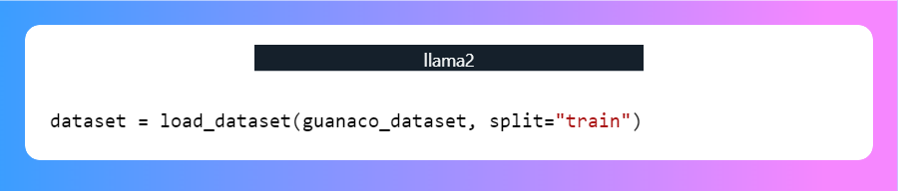
How to Fine-Tune Llama 2: A Step-By-Step Guide
Loading dataset, model, and tokenizer

Slide 9
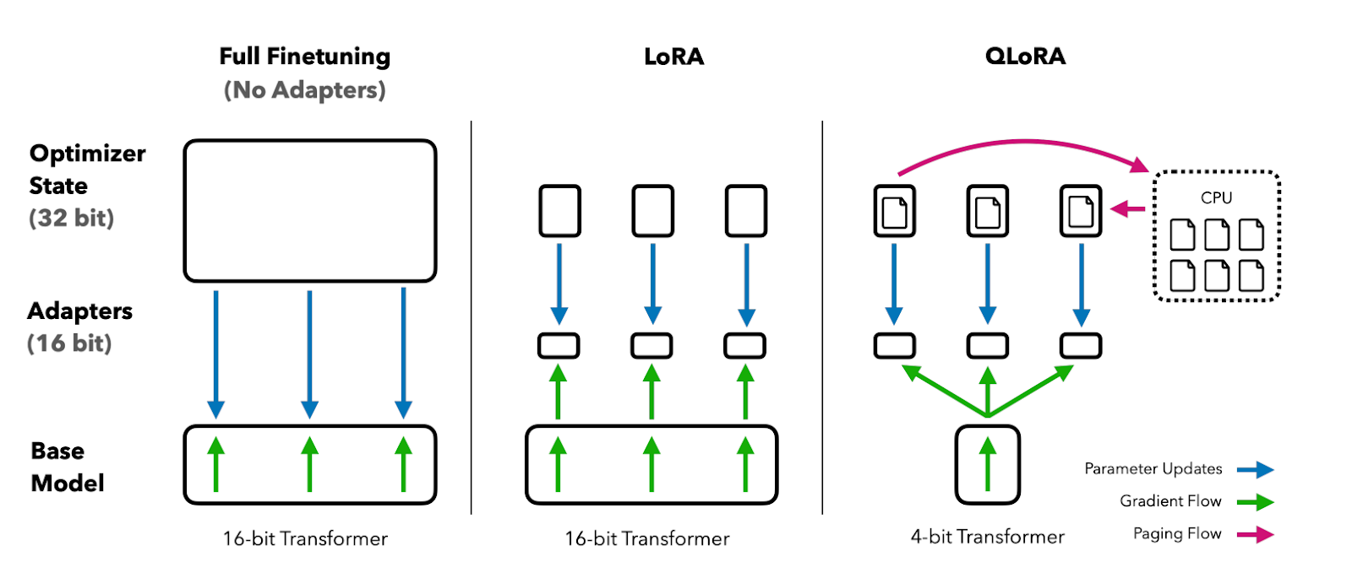
How to Fine-Tune Llama 2: A Step-By-Step Guide
4-bit quantization configuration
4-bit quantization via QLoRA allows efficient finetuning of huge LLM models on consumer hardware while retaining high performance. This dramatically improves accessibility and usability for real-world applications.

Slide 10
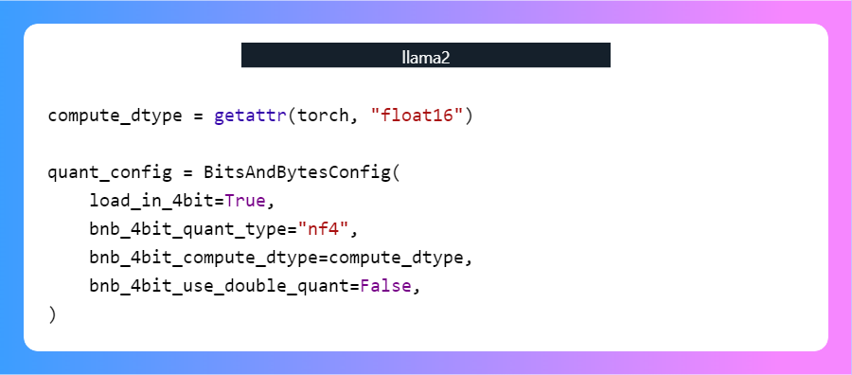
How to Fine-Tune Llama 2: A Step-By-Step Guide
In our case, we create 4-bit quantization with NF4 type configuration using BitsAndBytes.

Slide 11
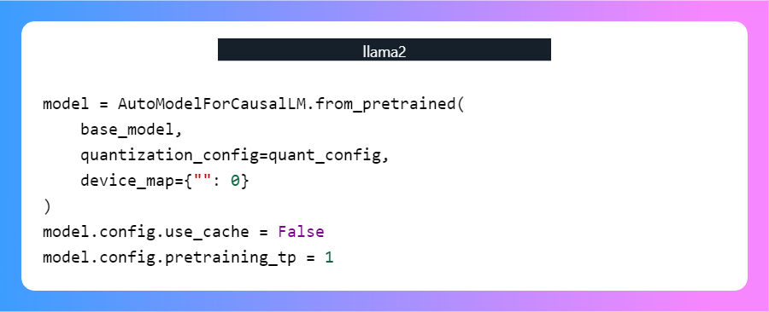
How to Fine-Tune Llama 2: A Step-By-Step Guide
Loading Llama 2 model-
We will now load a model using 4-bit precision with the compute dtype "float16" from Hugging Face for faster training.

Slide 12
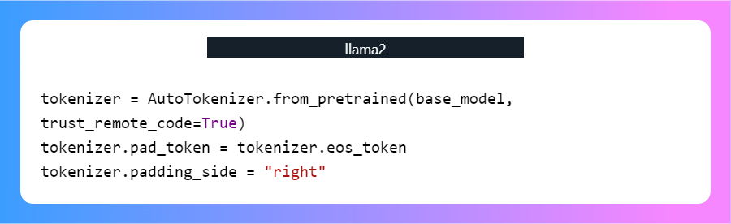
How to Fine-Tune Llama 2: A Step-By-Step Guide
Loading tokenizer-
We will now load a model using 4-bit precision with the compute dtype "float16" from Hugging Face for faster training.

Slide 13
How to Fine-Tune Llama 2: A Step-By-Step Guide
Training parameters-
output_dir: The output directory is where the model predictions and checkpoints will be stored.num_train_epochs: One training epoch.
fp16/bf16: Disable fp16/bf16 training.
per_device_train_batch_size: Batch size per GPU for training.
per_device_eval_batch_size: Batch size per GPU for evaluation.
gradient_accumulation_steps: This refers to the number of steps required to accumulate the gradients during the update process.
gradient_checkpointing: Enabling gradient checkpointing.
max_grad_norm: Gradient clipping.
learning_rate: Initial learning rate.
Training parameters-
weight_decay: Weight decay is applied to all layers except bias/LayerNorm weights.
Optim: Model optimizer (AdamW optimizer).
lr_scheduler_type: Learning rate schedule.
max_steps: Number of training steps.
warmup_ratio: Ratio of steps for a linear warmup.
group_by_length: This can significantly improve performance and accelerate the training process.
save_steps: Save checkpoint every 25 update steps.
logging_steps: Log every 25 update steps.
training_params = TrainingArgume

Slide 14
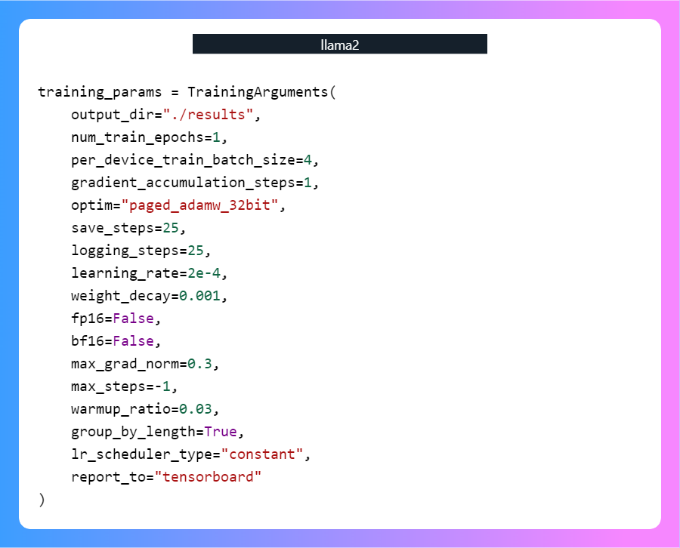
How to Fine-Tune Llama 2: A Step-By-Step Guide

Slide 15
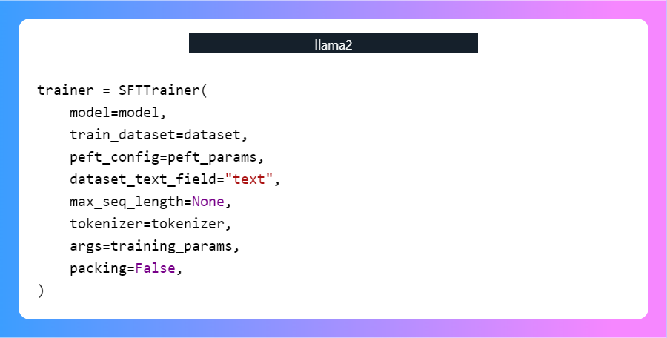
How to Fine-Tune Llama 2: A Step-By-Step Guide
Model fine-tuning-
Supervised fine-tuning (SFT) is a key step in reinforcement learning from human feedback (RLHF). The TRL library from HuggingFace provides an easy-to-use API to create SFT models and train them on your dataset with just a few lines of code.

Slide 16
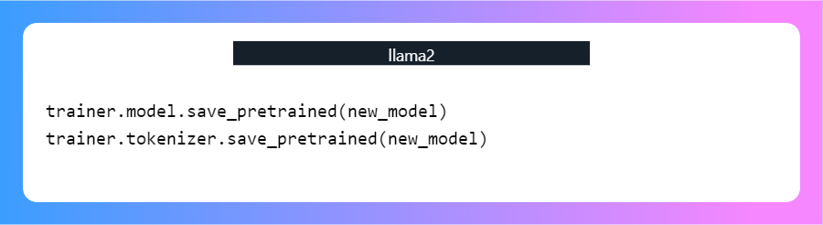
How to Fine-Tune Llama 2: A Step-By-Step Guide
After training the model, we will save the model adopter and tokenizers. You can also upload the model to Hugging Face using a similar API.

Slide 17
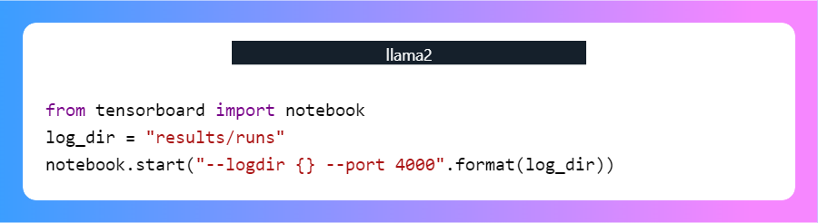
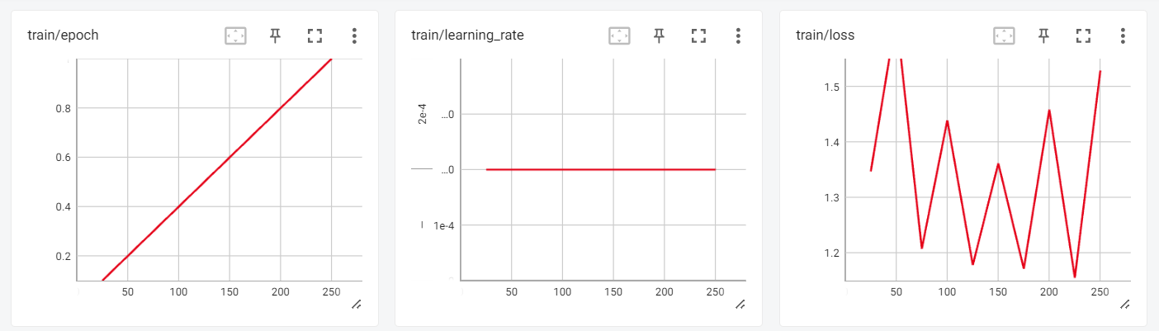
How to Fine-Tune Llama 2: A Step-By-Step Guide
Evaluation-

Slide 18
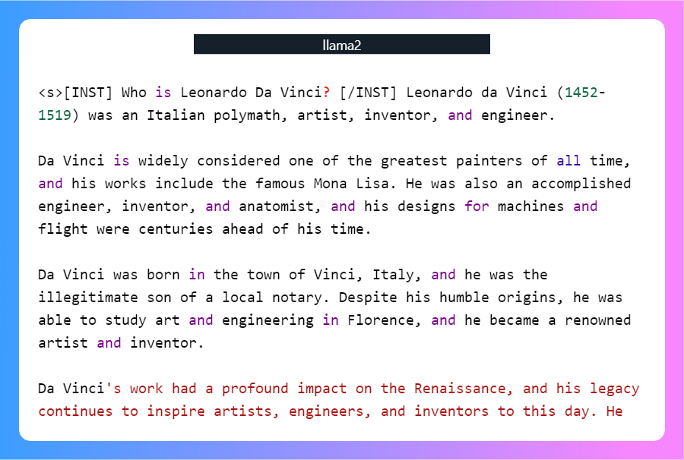
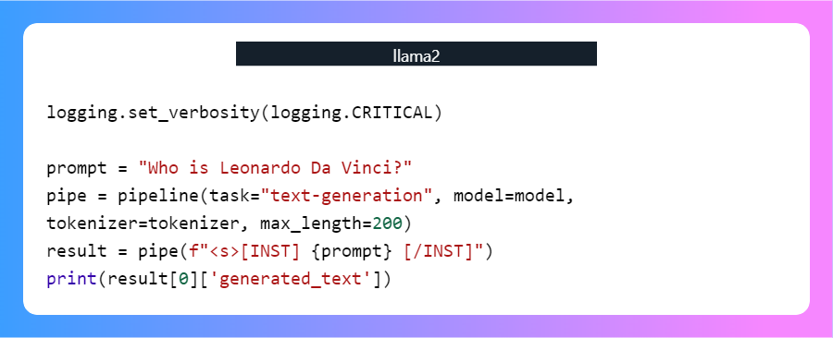
How to Fine-Tune Llama 2: A Step-By-Step Guide
Evaluation-
To test our fine-tuned model, we will use transformers text generation pipeline and ask simple questions like “Who is Leonardo Da Vinci?”.
As we can see, we got amazing results.

Slide 19
THANK YOU

